Slide 1
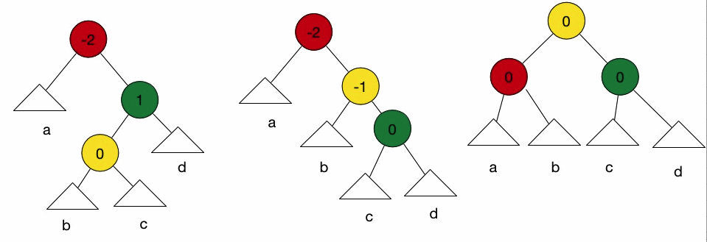
AVL Trees
Zareen Alamgir
Material taken mainly from
Mark Alan Weiss Book Chapter 4 (section 4.1 - 4.4)

Slide 2
Trees and balance
BST operations are closely related to height.
We want a tree with small height
A binary tree with N node has height at least
Θ(log N)
Our goal is to keep the height of a BST O(log N)
root
9
Some tree collections balance themselves as new nodes are added.
Balanced binary search trees.
AVL tree, red-black tree
6
14
4
8
19
height = 3
(balanced)
7

Slide 3
Calculating Tree height
Height is max number of nodes in path from root to any leaf.
height(leaf) = ?
height(A) = ?
Hint: it's recursive!
height(leaf) = 0
height(A) = 1 + max( height(A.left), height(A.right))
A
A.left
A.right

Slide 4
AVL trees
AVL Tree
a binary search tree that uses modified add and remove operations to stay balanced as its elements change
Invented in 1962 by two Russian mathematicians
(Adelson-Velskii and Landis)
A-V & L proved that an AVL tree's height is always O(log N).

Slide 5
AVL trees
Basic idea
If the tree becomes unbalanced after insert or delete operation, repair the tree until balance is restored.
Rebalancing operations are relatively efficient O(1)
Overall tree maintains a balanced O(log N) height
Fast to add/search

Slide 6
Balance Factor - BF
Balance factor (BF) for a tree node T
BF = height of T’s right subtree - height of T’s left subtree.
BF(T) = Height(T.right) - Height(T.left)
-2
AVL tree maintains a "balance factor" in each node of 0, 1, or -1
no node's two child subtrees differ in height by more than 1
It can be proven that the height of an AVL tree with N nodes is O(log N)
3
1
-2
0
-1
Node shows BF
0

Slide 7
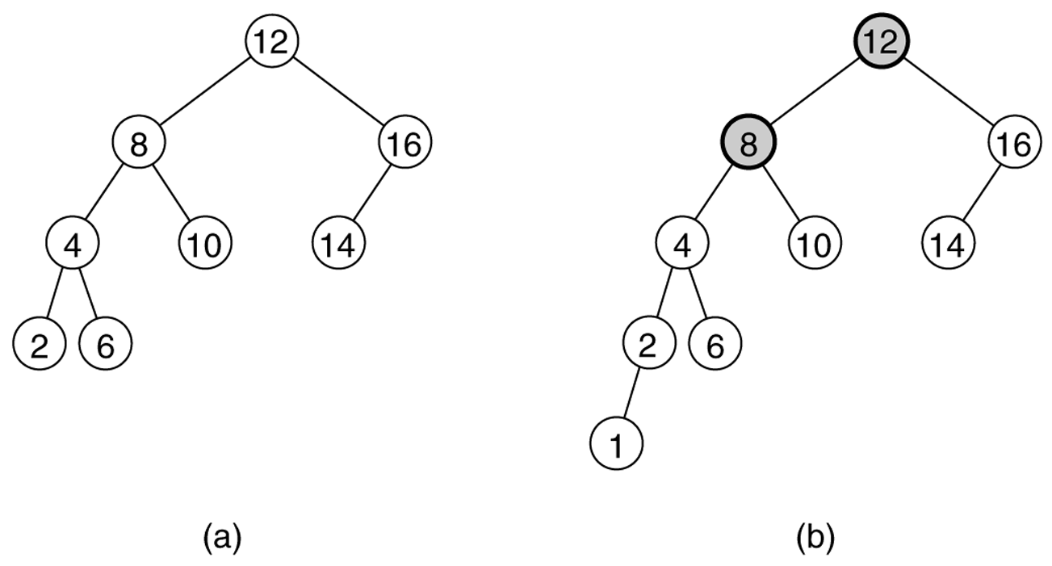
Is is an AVL tree ?
Each Node shows node value
AVL tree not an AVL tree
Notes:
(unbalanced nodes are darkened)

Slide 8
Tracking subtree height
Many of the AVL tree operations depend on height.
Height can be computed recursively by walking the tree; too slow.
Instead, each node can keep track of its subtree height as a field:
class AVLNode {
private:
int data;
int height;
AVLNode * left;
AVLNode * right;
}
10
data
3
3
height
10
left/ right
2
1
5
20
0
1
0
0
2
9
15
30
0
7

Slide 9
AVLTree Insert
For all AVL operations, the tree is balanced before the operation began.
Adding a new node
Just like BST, traversing left and right to find the proper location and insert the new node.
But adding this new node may unbalance the tree by 1
AVL.add(49)
55
29
87
13
42
49

Slide 10
AVL Insert
Which nodes in AVL tree has become unbalanced due to insert?
10
10
Consider the lowest node that has become unbalanced, and call it X
Add 3
2
15
2
5
7
7
3

Slide 11
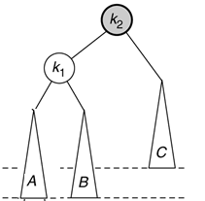
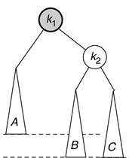
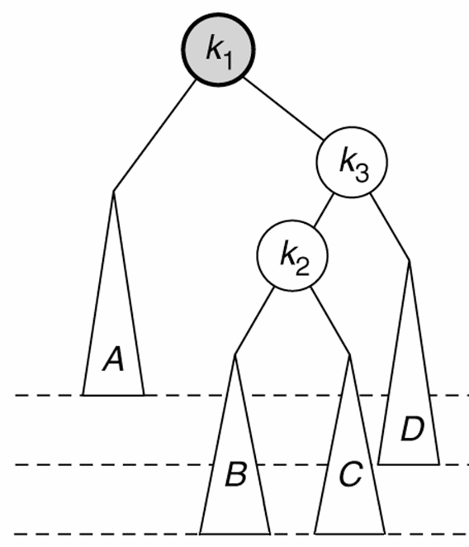
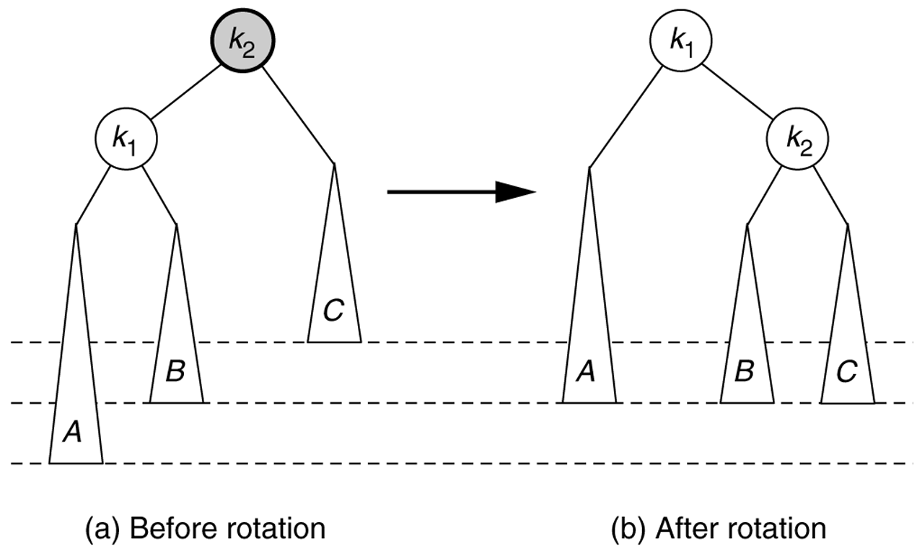
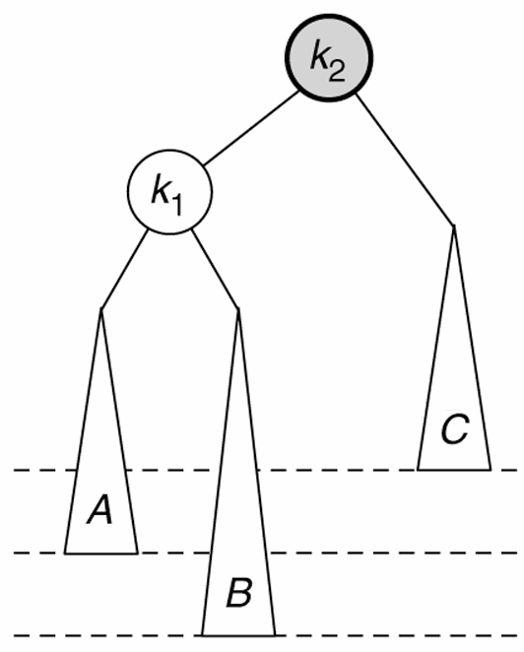
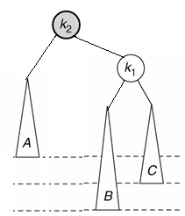
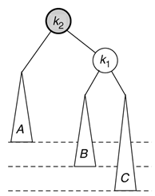
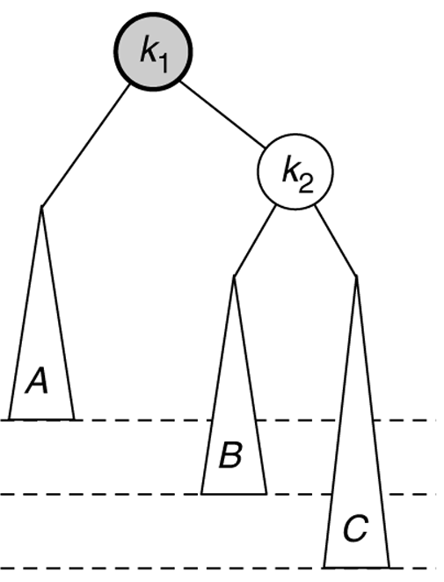
AVL Add cases
Balanced
AVL tree
x
x
y
y
Symmetric Case
Balance AVL Tree
h
h
h
h
A new node is inserted, the lowest node that becomes unbalanced is x.
There are four possibilities
x
x
x
x
y
y
y
y
A
B
B
C
h+1
h+1
h+1
h+1
1) Left-Left
2) Left-Right
3) Right-Left
4) Right-Right

Slide 12
Key idea: rotations
If a node has gone out of balanced in one direction
Rotate it in the opposite direction.
What is Rotation ?
Technically its a swap between parent and left or right child, maintaining proper BST ordering.
25
8
rotate right
8
3
25
3

Slide 13
Right Rotation
Right rotation (clockwise): (Fix Case1(LL))
left child y becomes parent
original parent x demoted to right
y's original right subtree B (if any) is attached to x as left subtree
x
y
y
x

Slide 14
Right rotation steps
Detach left child (11)'s right subtree (27) (don't lose it!)
Consider left child (11) be the new parent.
Attach old parent (43) onto right of new parent (11).
Attach new parent (11)'s old right subtree (27) as left subtree of old parent (43).
43
X
43
11
Y
11
11
65
65
8
43
8
27
8
27
3
27
65
3
3

Slide 15
Right rotation code
void AVLTree:: rightRotate(AVLNode *& x) {
// 1. detach Y(left child’s) right subtree
AVLNode * orphan = x->left->right;
// 2. consider Y(left child) to be the new parent
AVLNode * y = x->left;
// 3. attach old parent onto right of new parent
y1->right = x;
// 4. attach new parent's old right subtree as
// left subtree of old parent
x->left = orphan;
x->height = height(x); // update nodes'
y->height = height(y); // height values
x=Y;
}
x
y
y
x

Slide 16
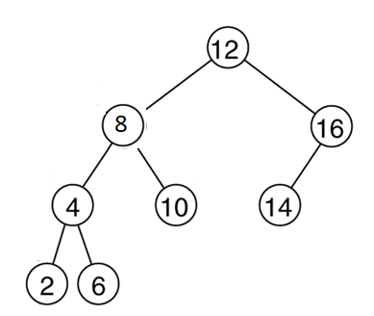
Right rotation example
Insert node with value=1
Which nodes have become unbalanced?
Which will be X ?
What is the balance factor of X before rotation?
1

Slide 17
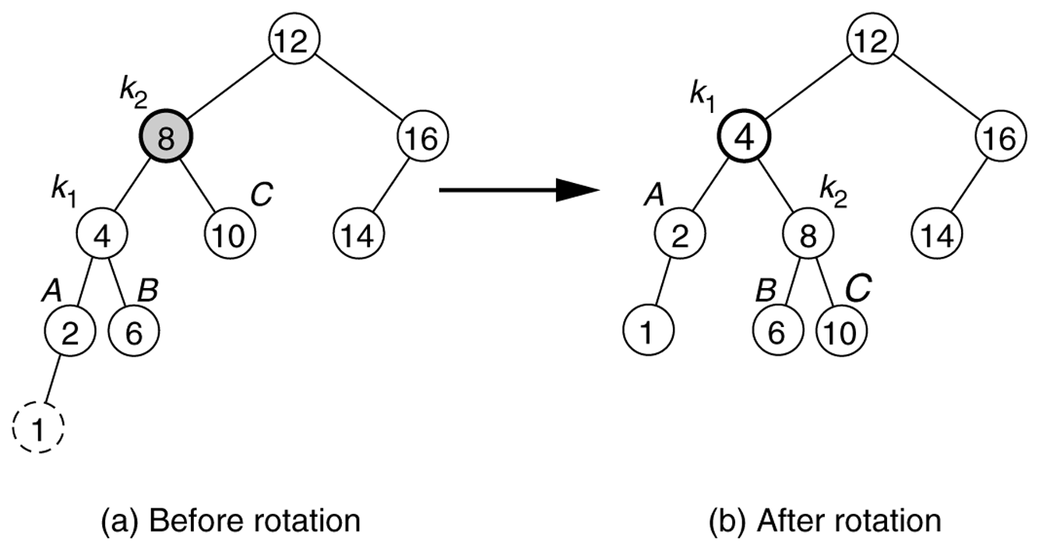
Right rotation example
What is the balance factor of X before rotation
What is the balance factor of X after rotating?
x
x
y
y
1
1

Slide 18
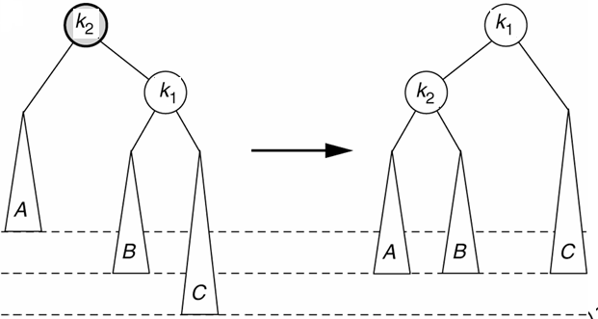
Left rotation
left rotation (counter-clockwise): (fixes Case 4 (RR))
right child y becomes parent
original parent X demoted to left
y's original left subtree B (if any) is attached to X as left subtree
x
y
y
x

Slide 19
Left rotation code
void AVLTree::leftRotate(AVLNode * & X) {
LEFT AS EXERCISE
}

Slide 20
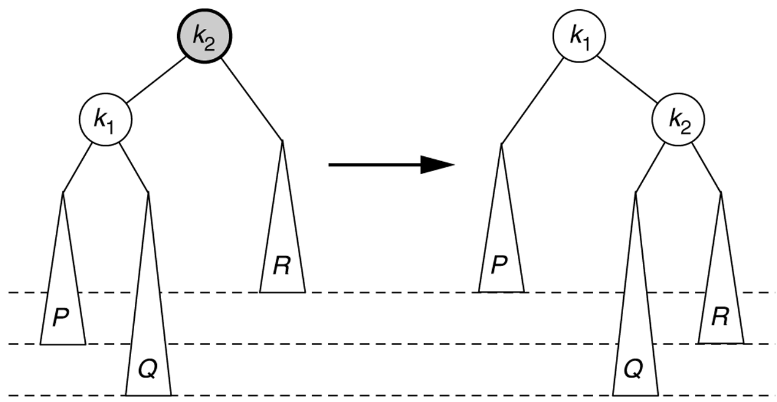
Left Right Case
A single right rotation
Does not fix Case 2 (LR).
Similarly, a single left rotation does not fix Case 3 (RL).)
Problem Case
X
Y
Y
X
C
A
A
C
B
B

Slide 21
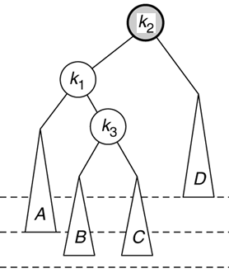
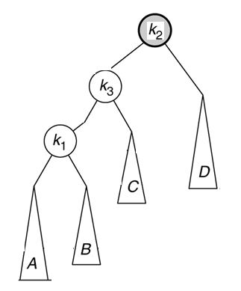
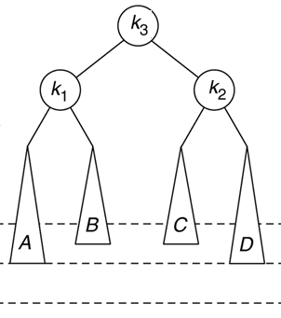
Left-right double rotation
left-right double rotation: (fixes Case 2 (LR))
1) left-rotate Y ... reduces Case 2 into Case 1
2) right-rotate X to fix Case 1
X
X
Z
Y
Z
Y
X
Z
Y

Slide 22
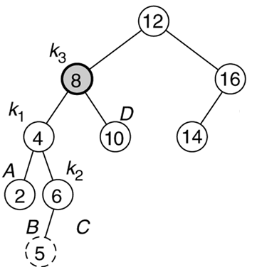
Left-right rotation example
What is the balance factor of Y, X, Z before and after rotating?
x
8
y
4
z
6

Slide 23
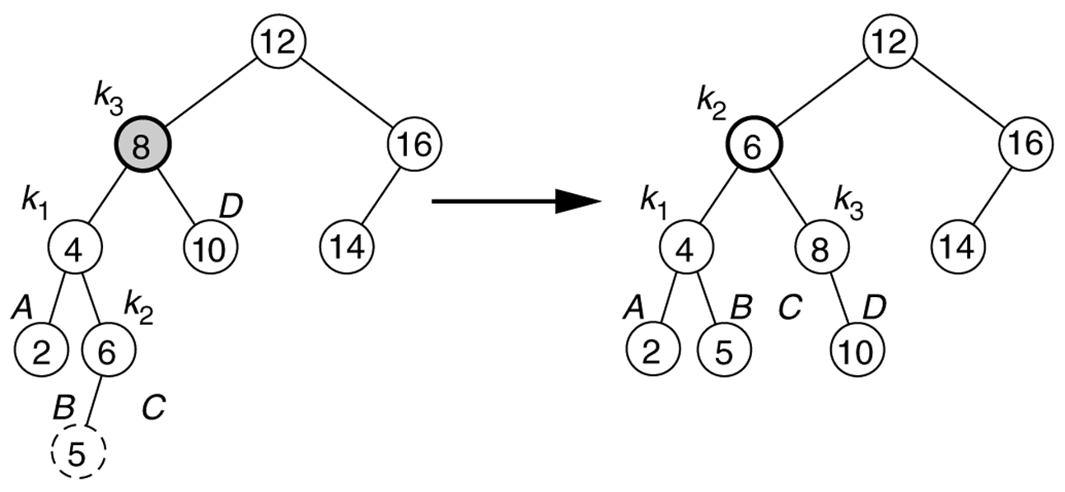
Left-right rotation example
What is the balance factor of Y, X, Z before and after rotating?
x
z
8
6
y
y
x
4
4
8
z
6

Slide 24
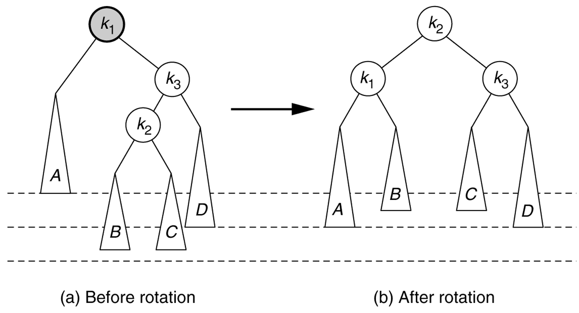
Right-left double rotation
right-left double rotation: (fixes Case 3 (RL))
1) right-rotate Y ... reduces Case 3 into Case 4
2) left-rotate X to fix Case 4
X
Y
Z

Slide 25
Right-left double rotation
right-left double rotation: (fixes Case 3 (RL))
1) right-rotate Y ... reduces Case 3 into Case 4
2) left-rotate X to fix Case 4
X
Z
Y
X
Y
Z

Slide 26
AVL Example 1
Numbers outside the node shows Height of the node
3
20
1
2
10
30
0
0
5
25
40
1
0
0
35
45
Now Insert 34

Slide 27
AVL Example 1
Numbers outside the node shows Height of the node
3
20
1
3
10
30
0
0
2
5
Imbalance
25
40
1
35
45
Insertion of 34
0
34

Slide 28
AVL Example 1
Numbers outside the node shows Height of the node
3
20
1
3
10
30
0
0
2
5
Imbalance
25
40
1
35
45
Insertion of 34
0
34

Slide 29
AVL Example 1
Insertion of 34
Numbers outside the node shows Height of the node
3
20
1
3
10
30
0
0
5
Imbalance
25
35
34
40
45

Slide 30
AVL Example 1
Numbers outside the node shows Height of the node
3
20
1
2
10
35
0
1
5
30
40
1
0
0
25
34
45

Slide 31
AVL Example 2
Insert 3
Insert 2
Insert 1
Single Right Rotation
3
3
2
3
2
2
1
3
1

Slide 32
An Example
Insert 4
2
1
3
4
Insert 5
2
Single Left Rotation
2
1
3
1
4
4
3
5
5

Slide 33
An Example
Insert 6
2
4
Single Left Rotation
1
4
2
5
3
5
3
6
1
6

Slide 34
An Extended Example
Insert 7
4
Single rotation
4
2
5
6
2
6
1
3
7
1
3
5
7

Slide 35
4
Insert 16 then 15
4
Double RL Rotation
2
6
2
6
1
3
5
7
X
15
Z
1
3
5
7
X
16
16
Y
Y
4
15
Z
2
6
1
3
5
15
7
16

Slide 36
4
Insert 14
2
6
4
Double rotation
1
3
5
7
2
6
X
15
Y
1
3
5
15
14
16
16
Z
7
4
14
2
7
1
3
6
15
5
14
16

Slide 37
DoubleRotation
void AVLTree::doubleLeftRightRotation(AvlNode*&X) { leftRotate ( X->left ); rightRotate( X ); }
void AVLTree::doubleRightLeftRotation(AvlNode*&X) { Left as EXERCISE }

Slide 38
AVL INSERT
First, insert the new key as a new leaf just as in ordinary binary search tree
Then trace the path from the new leaf towards the root.
For each node p encountered, check if heights of left(p) and right(p) differ by at most 1.
If yes, proceed to parent(p).
If not, restructure by doing either a single rotation or a double rotation
For insertion, once we perform a rotation at a node x, we won’t need to perform any rotation at any ancestor of x.

Slide 39
AVL INSERT
void insert(AvlNode * & t, int x) {
if (t == nullptr)
t = new AvlNode{ x, nullptr, nullptr };
else if (x < t->element)
insert(x, t->left);
else if (t->element < x)
insert(x, t->right);
balance(t);
}

Slide 40
AVL BALANCE
void balance(AvlNode * & t)
{
if (t == nullptr)
return;
if (height(t->left) - height(t->right) > ALLOWED_IMBALANCE)
if (height(t->left->left) >= height(t->left->right))
?????? Which Rotation
else
?????? Which Rotation
else if (height(t->right) - height(t->left) > ALLOWED_IMBALANCE)
if (height(t->right->right) >= height(t->right->left))
?????? Which Rotation
else
?????? Which Rotation
t->height = max(height(t->left), height(t->right)) + 1;
}

Slide 41
AVL DELETION

Slide 42
AVL DELETION

Slide 43
AVL DELETION
Deletion may be more time-consuming than insertion.
First, we apply DeleteByCopying to delete a node as in BST
This reduce the problem of deleting a node with two children to deleting a node with at most one child.
After a node has been deleted from the tree
Trace the path from the deleted node towards the root.
For each node p encountered, check the balance factor.
If balanced, proceed to parent(p).
If not, perform an appropriate rotation at p.

Slide 44
AVL DELETION
The rebalancing does not stop in DELETION after the first node X with balance factor ±2 is balanced as is the case with Insertion.
The deletion leads to at most O (lg n) rotations
because in the worst case, every node on the path from the deleted node to the root may require rebalancing.

Slide 45
AVL Delete Cases
When a node is deleted in subtree A, x becomes unbalanced.
x
Case:1a
x
BF=+2
y
BF=0
y
y
BF=+1
x
BF=0
A
A
C
h
h-1
h-1
C
h-1
C
A
h
h
h
h-1
Single
Left
Rotation
Balanced AVL tree
Balanced Tree
Deletion in A
x
Case:1b
x
BF=+2
y
BF=-1
y
y
BF=0
x
BF=+1
A
A
C
h
h
h-1
A
B
h-1
h
h
h
h
h
Single
Left
Rotation
Balanced Tree
Balanced AVL tree

Slide 46
AVL Delete Cases
When a node is deleted in subtree A, x becomes unbalanced.
BF=+2
x
x
BF=-1
y
y
A
A
h
h-1
B
B
h
h-1
h
h-1
After Deletion
Zig-Zag imbalance
Case:2

Slide 47
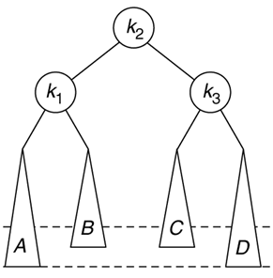
AVL Delete Cases
BF=+1
BF=+2
Z
BF=0
x
x
y
BF=-1
BF=-1
x
BF=0
y
BF=+1
y
A
BF=-1
BF=-1
Z
A
Z
h
h-1
A
B
C
D
C
h-1
h-1
h-1
C
h-1
h-2
h-2
h-1
After Double Rotation
Balanced AVL-Tree
After Deletion
Zig-Zag imbalance
Case:2 Expanded

Slide 48
AVL Delete Cases
BF=+1
x
BF=+2
Z
BF=0
x
y
BF=-1
y
BF=-1
x
BF=-1
y
BF=0
BF=+1
A
BF=+1
A
Z
Z
h
h-1
A
B
C
D
B
h-1
B
h-1
h-1
B
h-2
Balanced AVL-Tree
h-2
h-2
h-1
h-1
After Deletion Zig-Zag imbalance
Case:4 of Adam Drozdek book has same solution as case3 No NEED TO DISCUSS THIS
The case 4 differs from the case3. In case4 Z’s balance factor = +1 while in case3 Z’s BF=-1.
The same two rotations are needed to restore the balance factor of X
Case 3 and 4 can be processed together in a program processing AVL trees.

Slide 49
AVL Delete Cases
There are two cases in Deletion
And
two Symmetric cases
(Left as exercise)
NOTE:
Two Single Rotation cases we discussed for deletion are same no need to distinguish between them when performing rotation
Deletion of a node may not need an immediate rotation
It may improve the balance factor of its parent (from ±1 to 0),
BUT it may also degrade the balance factor for the grandparent (from ±1 to ±2).

Slide 50
AVL REMOVE
void remove(const int & x, AvlNode * & t){
if (t == nullptr)
return; // Item not found; do nothing
if (x < t->element)
remove(x, t->left);
else if (t->element < x)
remove(x, t->right);
else if(t->left !=nullptr && t->right !=nullptr){//Two children
t->element = findMin(t->right)->element;
remove(t->element, t->right);
}
else{
AvlNode *oldNode = t;
if(t->left != nullptr) t=t->left
else t=t->right;
delete oldNode;
}
balance(t); // same as insertion
}
Notes:
t = (t->left != nullptr) ? t->left : t->right;
If (t->left != nullptr) t=t->left else t= t->right;

Slide 51
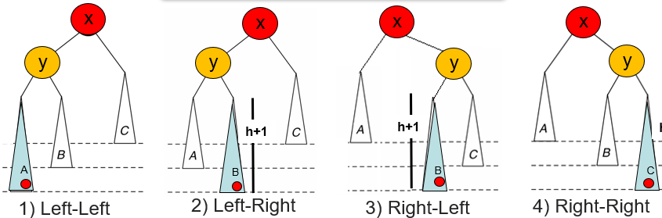
AVL BALANCE
void balance(AvlNode * & x) {
if (x == nullptr)return;
if (height(x->right) - height(x->left) < -1)
if (height(x->left->left) >= height(x->left->right))
?????? Which Rotation
else
?????? Which Rotation
else if (height(x->right) - height(x->left) > 1)
if (height(x->right->right) >= height(x->right->left))
?????? Which Rotation
else
?????? Which Rotation
t->height = max(height(x->left), height(x->right)) + 1;
}
Notes:
void AVLTree::doubleLeftRightRotation(AvlNode*&X) { leftRotate ( X->left ); rightRotate( X ); }
void AVLTree::doubleRightLeftRotation(AvlNode*&X) { Left as EXERCISE }

Slide 52
AVL BALANCE
void balance(AvlNode * & x) {
if (x == nullptr) return;
if (height(x->right) - height(x->left) > -1)
if (height(x->left->left) >= height(x->left->right))
rightRotation(t);
else
doubleLeftRightRotation(t);
else if (height(x->right) - height(x->left) > 1)
if (height(x->right->right) >= height(x->right->left))
leftRotation(t);
else
doubleRightLeftRotation(t);
t->height = max(height(t->left), height(t->right)) + 1;
}
doubleLeftRightRotation(AvlNode*&X){ leftRotate ( X->left ); rightRotate( X ); }
Notes:
void AVLTree::doubleLeftRightRotation(AvlNode*&X) { leftRotate ( X->left ); rightRotate( X ); }
void AVLTree::doubleRightLeftRotation(AvlNode*&X) { Left as EXERCISE }

Slide 53
AVL Example
Delete 10
50
B.F = 2
30
X
70
B.F = -1
10
40
Y
55
90
Double rotation
95
32
Z
52
80
85

Slide 54
AVL Example
Delete 10
50
30
X
70
32
Z
55
90
Double rotation
95
40
52
80
Y
85

Slide 55
AVL Example
Delete 10
Trace back to parent and
Check balance
50
32
70
30
40
55
90
95
52
80
85

Slide 56
AVL Example
Delete 10
50
X
B.F = 2
Same sign
Single Left Rotation
Y
B.F = 1
B.F = 0
32
70
30
40
55
90
95
52
80
85

Slide 57
AVL Example
Delete 10
50
X
Y
32
70
30
40
55
90
95
52
80
85

Slide 58
AVL Example
Delete 10
Y
70
X
50
90
95
32
55
80
30
40
52
85

Slide 59
AVL Example
Delete 10
Y
70
X
50
90
95
32
55
80
30
40
52
85

Slide 60
AVL Example
Delete 70
Deletion by copy
Find max in left subtree of 70
70
50
90
95
32
55
80
30
40
52
85

Slide 61
AVL Example
Delete 70
Deletion by copy
Find max in left subtree of 70
55
50
90
95
32
80
30
40
52
85

Slide 62
AVL Example
Delete 70
Deletion by copy
Find max in left subtree of 70
55
50
90
95
32
80
30
40
52
85

Slide 63
AVL Example
Insert 75
70
50
90
95
32
52
80
30
40
75
85

Slide 64
AVL Example
Delete 95
70
B.F = -2
50
90
95
32
52
80
B.F = 0
30
40
75
85

Slide 65
AVL Example
Delete 95
70
B.F = -2
50
90
32
52
80
B.F = 0
30
40
75
85

Slide 66
AVL Example
Delete 95
70
B.F = 0
B.F = 1
50
80
32
52
75
90
B.F = -1
30
40
85

Slide 67
AVL Example
Insert 77
Insert 72
Insert 76
70
B.F = 1
B.F = -1
50
80
32
52
90
75
B.F = 1
30
40
85
72
77
76

Slide 68
AVL Example
Delete 30
Delete 40
70
B.F = 1
B.F = -1
50
80
32
52
90
75
30
40
85
72
77
76

Slide 69
AVL Example
Trace Back and
Check balance factor
70
B.F = 2
B.F = 0
50
B.F = -1
80
B.F = 0
32
52
90
75
85
72
77
76

Slide 70
AVL Example
Rebalance
Double Rotation
Rotate Right 80
Rotate Left 70
70
B.F = 2
B.F = 0
50
B.F = -1
80
B.F = 0
32
52
90
75
85
72
77
76

Slide 71
AVL Example
Rebalance
Double Rotation
Rotate Right 80
Rotate Left 70
70
B.F = 0
50
80
B.F = 0
32
52
75
90
72
77
85
76

Slide 72
AVL Example
Rebalance
Double Rotation
Rotate Right 80
Rotate Left 70
70
50
75
80
32
52
72
90
77
85
76

Slide 73
AVL Example
Rebalance
Double Rotation
Rotate Right 80
Rotate Left 70
70
50
75
80
32
52
72
90
77
85
76

Slide 74
AVL Example
Rebalance
Double Rotation
Rotate Right 80
Rotate Left 70
75
70
80
72
50
90
77
32
52
85
76

Slide 75



Maximum height of AVL Tree
Let A be an AVL tree of height h
Let N_{h} = the min no. of nodes in an AVL tree of height h
Clearly, N_{i} ≥ N_{i-1} by definition
We have
root
9
$$N_{h}≥N_{h−1}+N_{h−2}+1$$
6
14
$$\begin{matrix} & ≥2N_{h−2}+1\end{matrix}\begin{matrix} & \end{matrix}$$
4
8
19
7
$$\begin{matrix} & >2N_{h−2}\end{matrix}$$

Slide 76




Maximum height of AVL Tree
By repeated substitution, we obtain the general form
$${ N}_{h}>{2N}_{h−2} \\ \begin{matrix} & \begin{aligned}>2{(2 N}_{h−4}) \\ >2(2{(2 N}_{h−6}))\end{aligned}\end{matrix}$$
…
$\begin{matrix} & { N}_{h}>2{i N}_{(h−2i)}\end{matrix}$
h-2i =0
…
$N_{h}>2{h\backslash 2 N}_{(0)}$
The boundary conditions are: N₀=1 and N₁ =2.
$h<\text{2}\text{log} \text{Nh}$ … thus, h = O(log N_{h}).
Operations (search, insert, delete) on an AVL tree will take O(log N) time.
Notes:
Give example of N₁₀ >2N₈

